Slide 1
BFX AT-100_FA_1pc scrap
Prepare by: PE – JUSTIN
Date: 2025/04/17

Slide 2
Problem Description
Issue Description (5W1H)
When | 2025-APR-17
Who | SH Son
Where | ALT customer side
What | ALT customer complain 1pc scrap T99X171.00 need to additional defect analysis
Why | L308, L306, RV301, C338, U308, R328 components were burnt
How | NG product can’t boot up, no HDMI signal, no Ping
How much | 1/91pcs scrap ~ 1.09%, S/N range: 2149688001202404122919

Slide 3

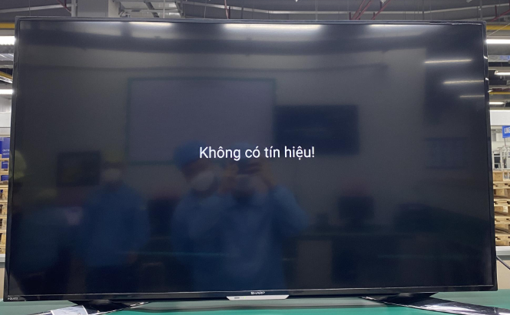
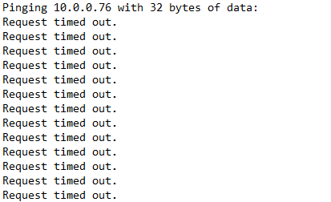
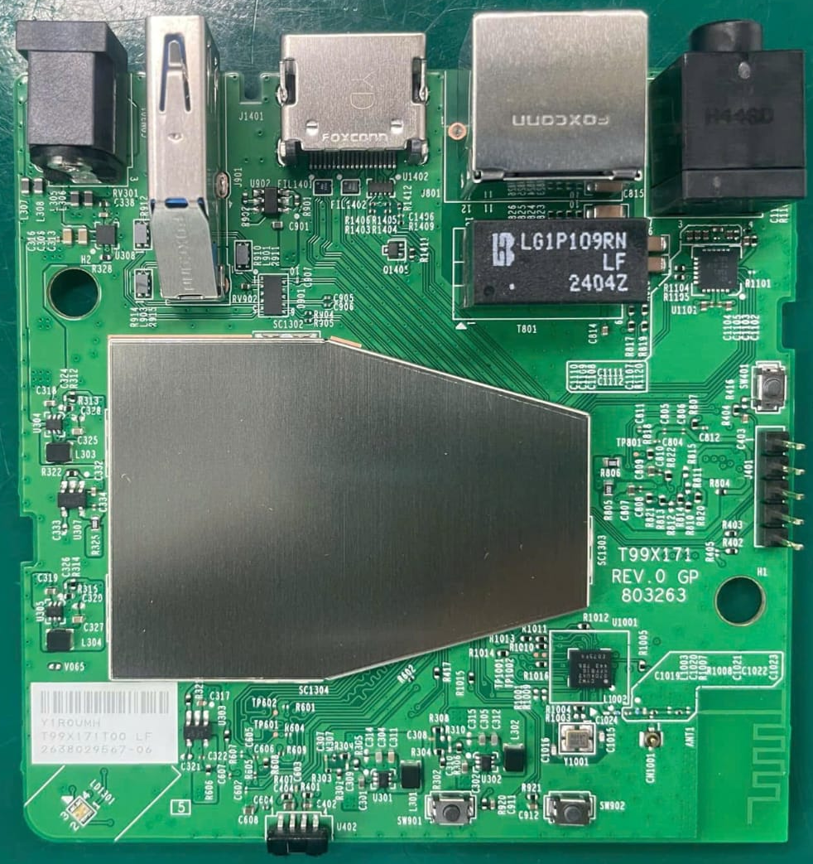
Verify fail symptom
Sorting:
- Power on (use adapter 5V2A) + HDMI cable + ethernet cable connect with DUT
➔ Product #2149688001202404122919 can’t boot up, no HDMI, no ping
PC
Ip: 10.0.0.100
Power
5V2A
Internet Router
Can’t boot up, no HDMI
No ping(10.0.0.76)
Power In
HDMI
ETH
Ip: 10.0.0.1
Summary:
- Product #2149688001202404122919 boot up fail
Sample
Ip: 10.0.0.76
Layout sorting RMA T99X171.00

Slide 4
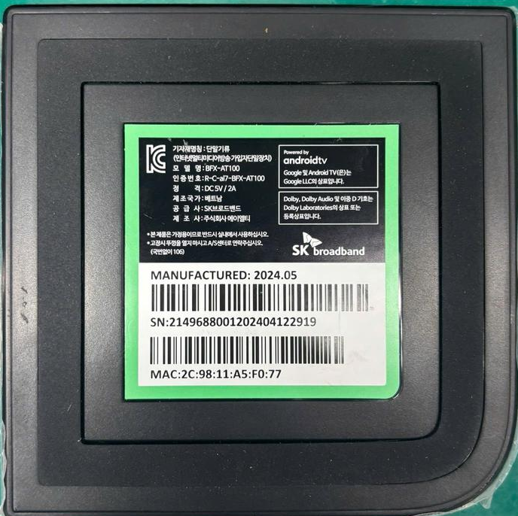
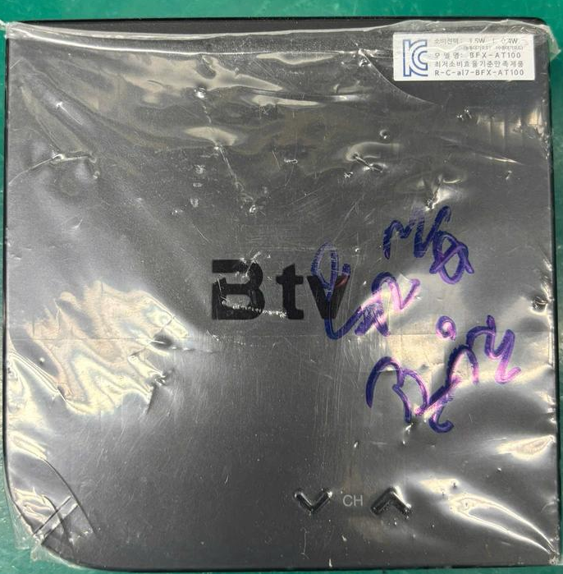
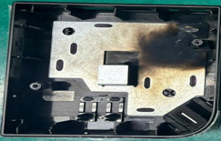
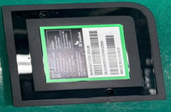
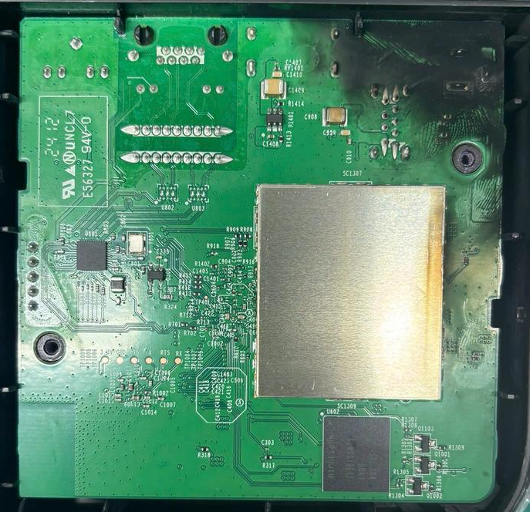
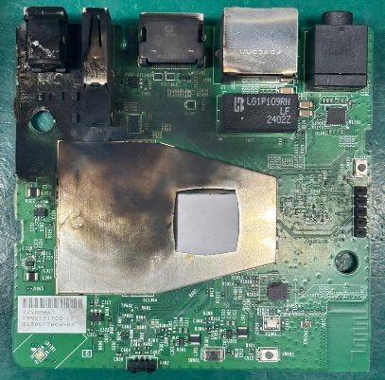
VI checking
VI NG DUT:
SN range | VI | Side |  | Result
 |  | TOP | BOT
#2149688001202404122919 | Housing |  |  | - Normal
 | Open housing |  |  | - Housing was burnt and black smoke residue
 | PCBA |  |  | - Power supply port area was burnt and black smoke residue - Location: L308, L306, RV301, C338, U308, R328 were burnt
Summary:
- Product was seriously burnt and exploded, PCBA was damaged

Slide 5
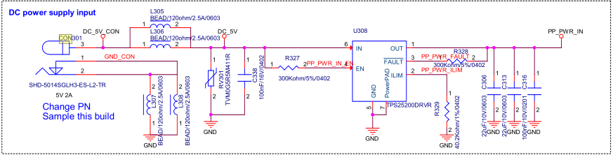
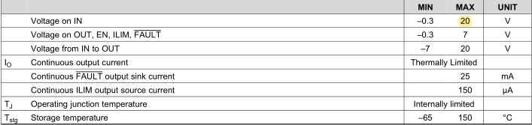
Cause burn evaluation
Cause burn
Material | Voltage limits
 | MIN | MAX
U308 | -0.3V | 20V
L308 | N/A | 300V
L306
RV301 | 5.5V | 30V
C338 | 4V | 16V
R328 | N/A | 50V
Datasheet U308_TPS25200
Component input voltage limit
Summary:
- Maybe IC U308 was damaged due to input overvoltage or a lightning strike, resulting in electrical overstress beyond its maximum voltage tolerance.

Slide 6
Summary
No.# | Items | Result | Owner
1 | Fail symptom | Product can’ boot up, no HDMI, no ping | PE: Justin, PQE: Rachel, TE: Jones
2 | VI checking | L308, L306, RV301, C338, U308, R328, J901, L902 were burnt, PCBA was damaged | PE: Justin
4 | Assessment root cause burn | U308_TPS25200 was damaged due to input overvoltage or a lightning strike, resulting in electrical overstress beyond its maximum voltage tolerance | PE: Justin
Possible causes include:
- Adapter failure: Output voltage surged beyond 20V due to internal fault.
- Lightning strike or surge on the AC line, transferred through the adapter.
- Reverse or incorrect power input at the DC jack.

